Slide 1
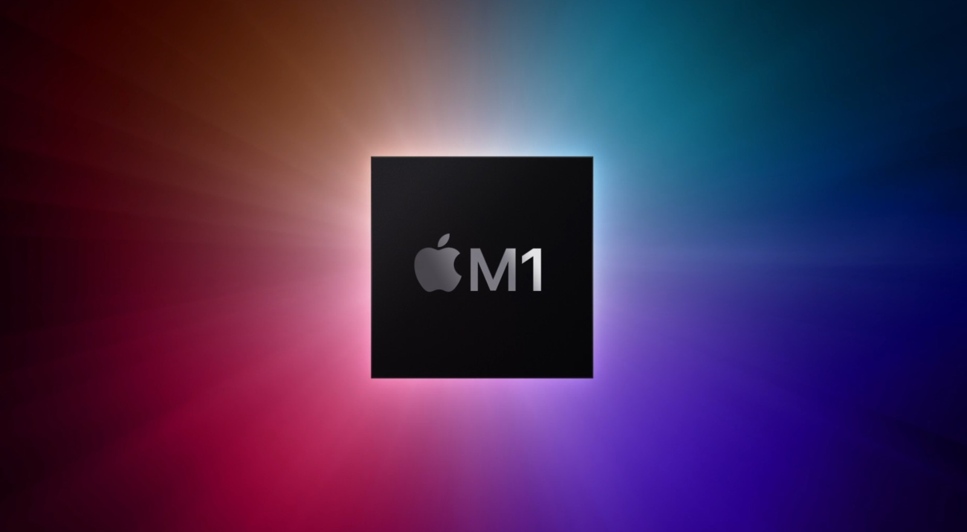
Team A
Firuze
Ilahe
Zakhra

Slide 2
Apple M1 Chip
A processor that Apple developed in-house powers the newest Macs and iPad Pro. It's a mighty powerful chip, but it's not without a few quirks. Here's everything you need to know if you're in the market for an M1-powered Apple product.
Apple’s newest Macs don’t come with Intel processors. Instead, they use the brand-new Apple M1 chip, a powerful replacement for the many generations of Intel CPUs that have powered Apple computers since 2006.
The M1 is the first appearance of the new paradigm that Apple has dubbed Apple Silicon. The new Macs available with the M1 include the MacBook Air, the 13-inch MacBook Pro, the Mac mini, and the new 24-inch iMac. The newest iPad Pro also uses the M1.

Slide 3
The M1: An Entire System on a Chip
Whether they run Windows, macOS, or Chrome, most of today’s PCs come with an array of computing components inside that each handle different processing tasks. These include one processor (the CPU) for handling essential computations, including those used for browsing the internet and opening and closing apps, and another (the GPU) for processing graphics computations and outputting a signal to your monitor or laptop screen.

Slide 4
As an evolution of the Apple A-series processors that have long powered the iPhone and the iPad, the M1 chip takes a different approach. Instead of a collection of separate processing parts, it’s a single system on a chip (SoC). The SoC handles all of the computations, including graphics output, which means that each software instruction can use the most efficient part of the M1.

Slide 5
In part because it must do everything at once, the M1 has an eyebrow-raising maximum of 16 processor cores. That sounds like a ton compared with the six cores that are in the most powerful Intel laptop CPUs. In fact, the M1 has so many cores not so it can perform tasks more quickly, but so it can perform more tasks.

Slide 6
Artificial Intelligence and the M1 Chip
Artificial intelligence (AI) and machine learning (ML) algorithms are essential to helping modern software run smoothly. Apple A-series and Intel Core processors have long had AI capabilities built in, and the M1 is no different. It has a dedicated neural engine with 16 processing cores of its own to handle AI tasks.

Slide 7
How Fast Is the M1 Chip?
According to Apple, the M1 chip is faster than the Intel processors in the Macs it replaces. In some cases, the company claims, it’s much faster. General performance of the M1 MacBook Air is 3.5 times faster than before, while graphics performance is five times faster, Apple says. On the M1 MacBook Pro, AI computation is 11 times faster than before, and Apple says that it can build code in the Xcode app up to 2.8 times faster.

